Slide 1
Project for software engineering

Slide 2
Introduction
Java Swing programming language used for Wandering in the Woods game development.
Helps students to learn computation, math concepts, computer science, and computational thinking.
Three levels have been used in developing gaming software.
Each level has some set of players to play the game.
The result is generated after the game ends.

Slide 3
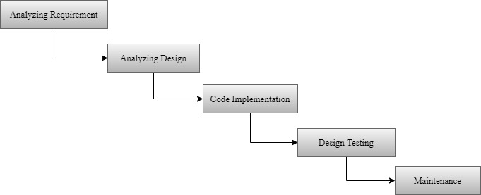
Process model
Figure 1 – Flow diagram for Wandering in the Woods game

Slide 4
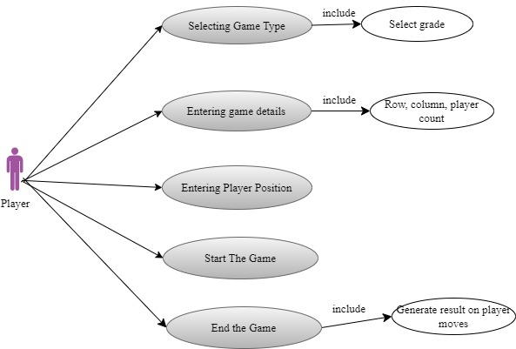
Use case
Figure 2 – Use case diagram

Slide 5
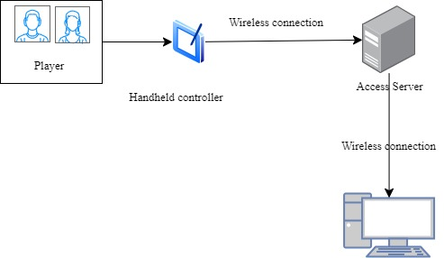
Deployment diagram
Figure 3 – Deployment diagram

Slide 6
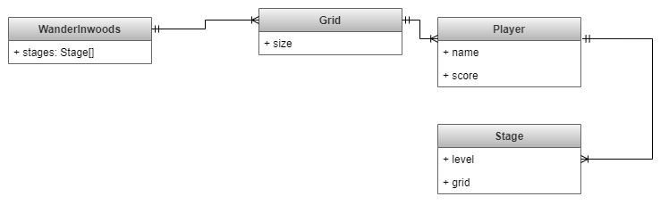
Class diagram
Figure 4 – Class diagram

Slide 7
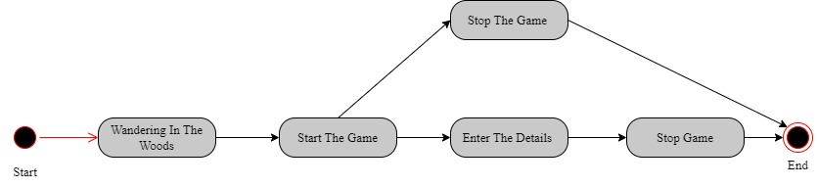
State diagram
Figure 5 – State diagram

Slide 8
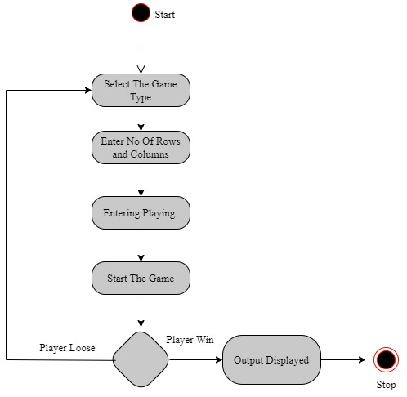
Activity diagram
Figure 6 – Activity diagram

Slide 9
Personas
A maximum of 8 players been allowed for the designed game.
Grade K-2 stage requires 2 players.
Grade 3-5 Stage requires a maximum of 4 players
Grade 6-8 grade allows 8 maximum players to play the game with the necessary row and column selection.

Slide 10
GUI Mock-up
The first window allows the players to select the grade.
Next Window allows the player to select rows, columns, and player count.
Players start the game after the details specification.
The game ends when the player meets in the same grid.
Output is generated after the game ends.

Slide 11
Testing strategy
Undergone to satisfy all the stated requirements.
Determined testing strategies for the Wandering in the Woods game,
Unit testing
Integration testing
System testing
Performance testing

Slide 12
References
A. Y. Aleryani, "Comparative Study between Data Flow Diagram and Use case diagram," International Journal of Scientific and Research Publications,, vol. 6, no. 3, pp. 124-127, 2016.
H. S. D. Y. W. Bingyang Wei, "From state diagrams to sequence diagrams: a requirements acquisition approach," International Journal of Computers and Applications, vol. 41, no. 3, pp. 1-23, 2017.
J. I. A. A. D. T. Tanwir Ahmad, "Model-based testing using UML activity diagrams: A systematic mapping study," Computer Science Review, vol. 33, pp. 98-112, 2019.
S. S. Isha, "Software Testing Techniques and Strategies," International Journal of Engineering Research and Applications, vol. 4, no. 4, pp. 99-102, 2014.
Sathyavathy, "Review of Software Testing Techniques and Strategies," International Journal of Research in Advent Technology, vol. 5, no. 11, pp. 66-70, 2017.
S. Pargaonkar, "A Comprehensive Review of Performance Testing Methodologies and Best Practices: Software Quality Engineering," International Journal of Science and Research, vol. 12, no. 8, pp. 2008-2014, 2023.

